Slide 1


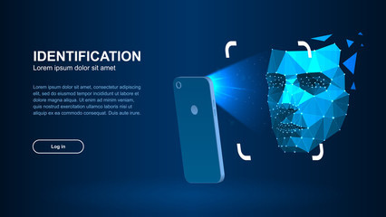

FACE RECOGNITION
Real-time face recognition using OpenCV and Deep Learning
-- BY KOMAL PATANKAR & RUTUJA SONWANE

Slide 2

WHAT IS OpenCV ?
01
OpenCV, short for Open Source Computer Vision Library.
02
Supports multiple programming languages, such as C++, Python, and Java
03
Offers operations for reading, writing, and transforming images and video files.
04
Provides tools for image classification, object detection, and 3D reconstruction.
05
Face recognition, motion tracking, augmented reality, gesture recognition,
You can describe the topic of the section here
You can describe the topic of the section here

Slide 3
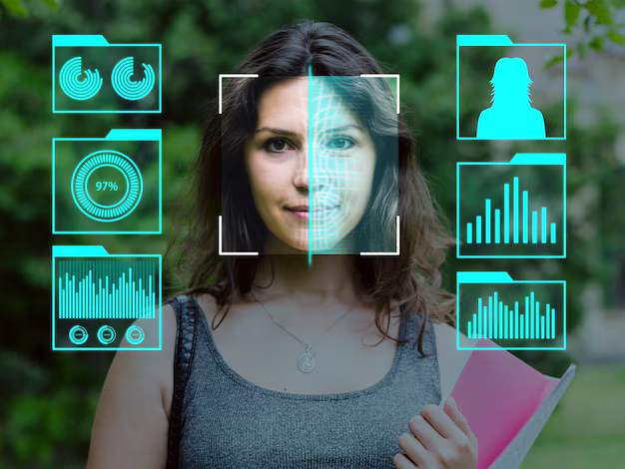
WHAT IS FACE RECOGNIOTION ?

Slide 4
What is Face Recognition?
01
Face Recognition is a biometric technology used to identify or verify a person’s identity by comparing their facial features.
02
It is widely used in security, authentication, and even in social media for tagging people in images.
Face Detection: Locating the face in an image.
Feature Extraction: Extracting key features (like eyes, nose, etc.).
Face Recognition: Matching detected faces to known identities.

Slide 5
Face Recognition Algorithm:
Haar Cascade Classifiers
These are pre-trained machine learning models that identify features characteristic of faces.
Deep Learning Models
OpenCV's deep learning algorithms, that enable tasks such as image classification and object detection by processing image features.
Real-Time Processing
These algorithms are optimized for speed and accuracy, enabling near-instantaneous detection in real-time applications

Slide 6
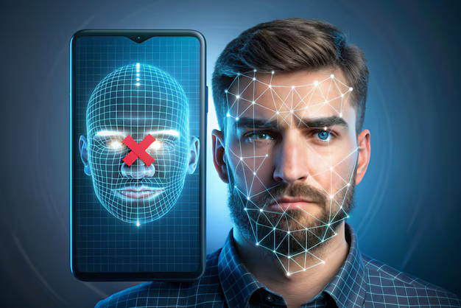
Import Libraries (cv2, os, numpy)
Load Haar Cascade for Face Detection
Define Function to Load Images from Dataset
Create LBPH Face Recognizer
Start Video Capture from Webcam
While Video is Capturing:
Capture Frame from Video
Convert Frame to Grayscale
Detect Faces in Frame
For Each Detected Face:
Recognize Face using LBPH Recognizer
Compare Confidence & Identify (Known/Unknown)
Draw Rectangles & Display Name on Frame
Display Processed Video Feed
Exit on Pressing 'q'
Release Video Capture Resources
FLOW OF
THE CODE..

Slide 7
THANK
YOU !!

